Slide 1
COMS E6998: Microservices and Cloud Applications Lecture 4: Composition, Integration, Orchestration, Pub/Sub, Message Queueing
Dr. Donald F. Ferguson
dff9@columbia.edu

Slide 2
Questions? Comments?

Slide 3
Swagger

Slide 4
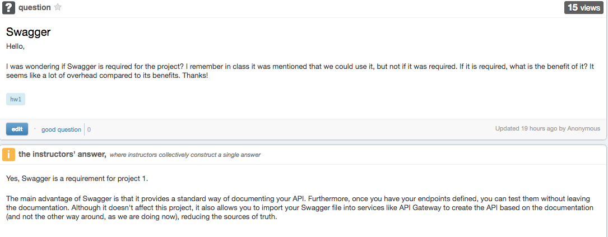
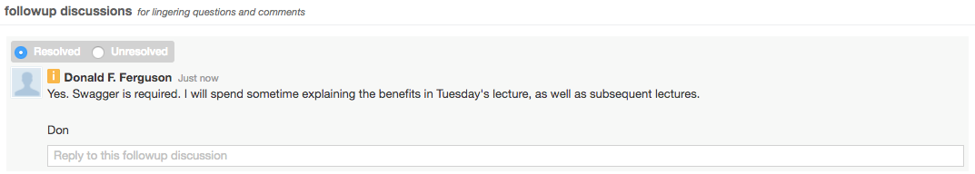
Swagger

Slide 5
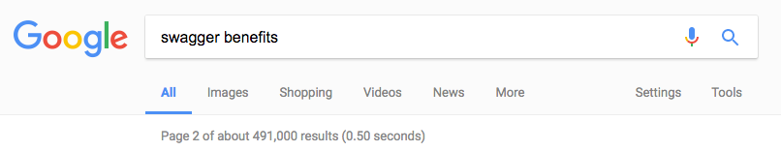
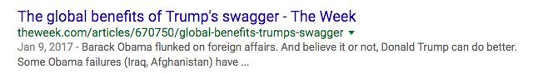
Swagger Benefits
OK. No search is perfect.

Slide 6
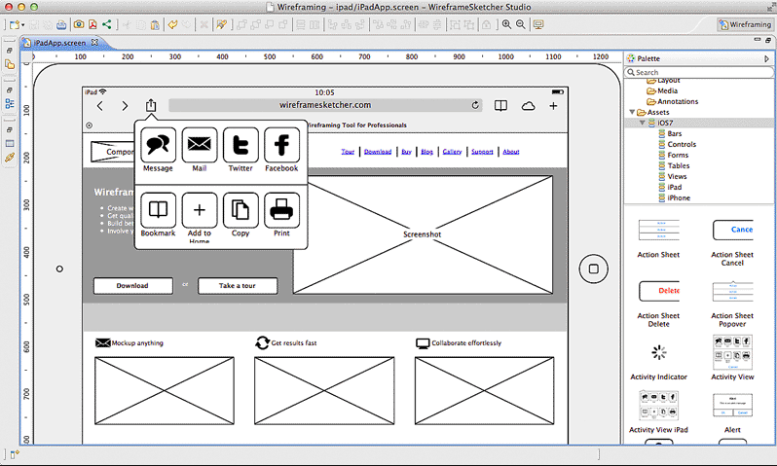
Reminder: (Some) Application Design Methodologies
Start with User Interface
Roles and personas.
Wireframes for pages and interactions.
Page flow/transition diagrams.
Start with Data Model
Entity types, properties.
Relationships/associations.
Constraints.
Operations.

Slide 7
Reminder: (Some) Application Design Methodologies
I intentionally omitted a methodology because the concepts is less familiar and we are going to discuss later. API First.
Start with User Interface
Roles and personas.
Wireframes for pages and interactions.
Page flow/transition diagrams.
Start with Data Model
Entity types, properties.
Relationships/associations.
Constraints.
Operations.

Slide 8
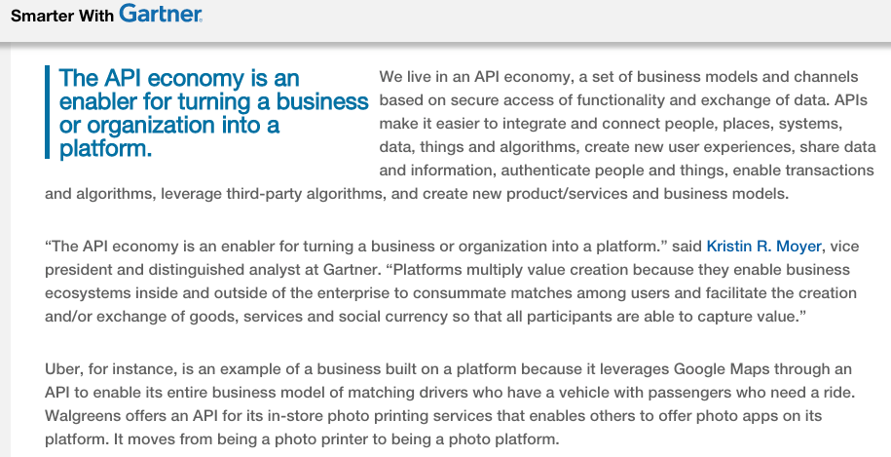
API Economy (http://www.gartner.com/smarterwithgartner/welcome-to-the-api-economy/)

Slide 9
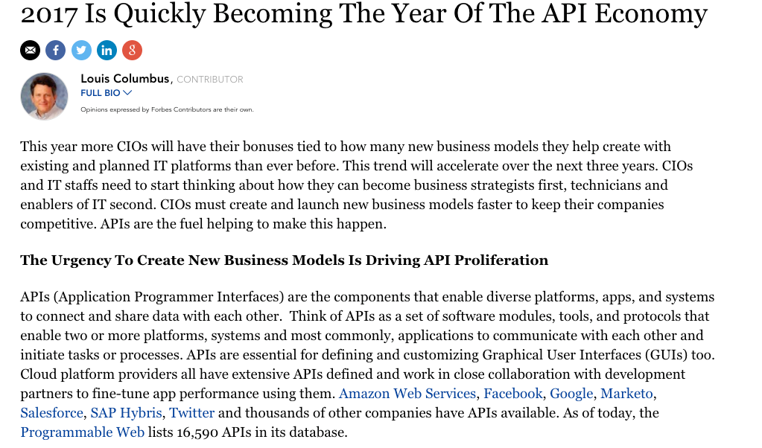
https://www.forbes.com/sites/louiscolumbus/2017/01/29/2017-is-quickly-becoming-the-year-of-the-api-economy/#4b3806fe6a41

Slide 10
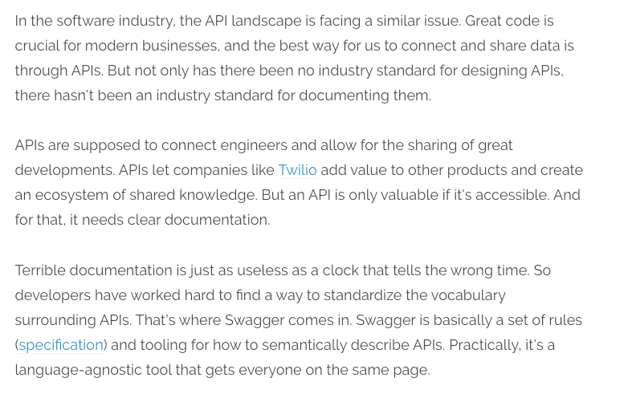
A Perspective (https://blog.readme.io/what-is-swagger-and-why-it-matters/)

Slide 11
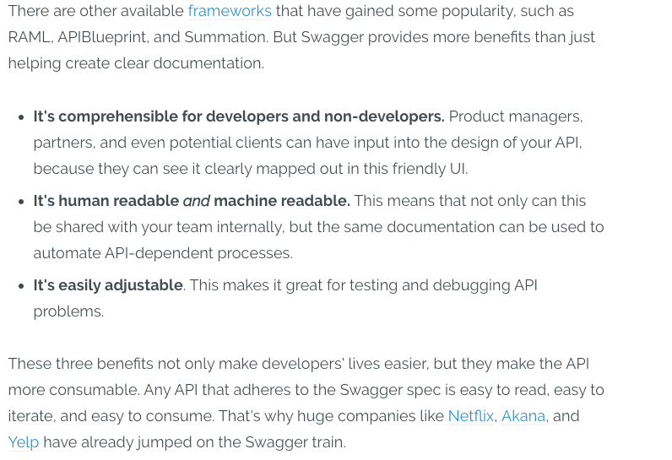
A Perspective (https://blog.readme.io/what-is-swagger-and-why-it-matters/)

Slide 12
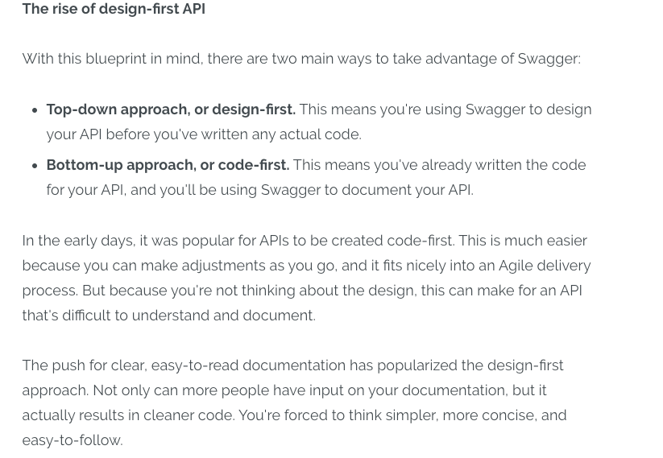
A Perspective (https://blog.readme.io/what-is-swagger-and-why-it-matters/)

Slide 13
Swagger
“It seems like a lot of overhead compared to its benefits.”
This observation is common the 1st time you start using a technology, e.g.
Relational Databases.
Frameworks, e.g. Spring, Express.
Schema design tools.
The benefit emerges as the scenarios become bigger and more complex.

Slide 14
Complex Application Environments

Slide 15
CRM
In CRM (customer relationship management), CRM software is a category of software that covers a broad set of applications designed to help businesses manage many of the following business processes:
customer data
customer interaction
access business information
automate sales
track leads
contracts
marketing
customer support
clients and contacts
support vendor / partner relationships
employees
knowledge and training
assets or resources
While CRM software is most commonly used to manage a business-customer relationship, CRM software systems are also used in the same way to manage business contacts, employees, clients, contract wins and sales leads. Typically, CRM software is used in the enterprise, however many products scale and can be used in a business of any size.
http://www.webopedia.com/TERM/C/crm_software.html
http://solutionleadership.blogspot.com/2010/02/how-to-lead-crm-solution.html

Slide 16
Enterprise Resource Planning
Enterprise resource planning (ERP) is the integrated management of core business processes, often in real-time and mediated by software and technology. These business activities can include:
product planning, purchase
production planning
manufacturing or service delivery
marketing and sales
materials management
inventory management
shipping and payment
finance
ERP is usually referred to as category of business-management software—typically a suite of integrated applications—that an organization can use to collect, store, manage and interpret data from these many business activities.

Slide 17
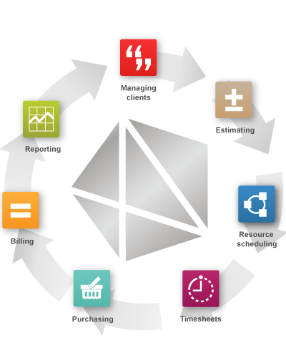
I Can Do This All Day
Finance and Accounting

Slide 18
Cloudscape
Our applications will
Call APIs
Use and run in PaaS

Slide 19
That was interesting, but why did you present?
These are some enterprise software examples, but the pattern is general.
There are three broad classifications of microservices
Basic building blocks for core functions.
Microservices that integrate and compose building blocks into solutions.
Microservices that integrate and compose solutions across the enterprise, and with other enterprises and partners.
This leads to three fundamental considerations.
Making individual microservices composable.
Design patterns and technology for integration and composition.
A large part of microservice and cloud development is composing, integrating and extending SaaS delivered solutions via APIs.

Slide 20
Simplistic Taxonomy of Integration/Composition
Integration Composition
UI
Information
Integration
Message/
Event
Workflow
Orchestration
ETL, MapReduce
Federated DB
CEP/CPE Message Flow
RT events
Human Centric
Automation

Slide 21
Automation (Workflow) (Orchestration)

Slide 22
Introduction

Slide 23
Simplistic Taxonomy of Integration/Composition
Integration Composition
UI
Information
Integration
Message/
Event
Workflow
Orchestration
ETL, MapReduce
Federated DB
CEP/CPE Message Flow
RT events
Human Centric
Automation

Slide 24
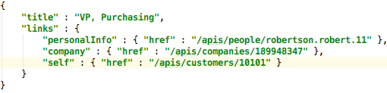
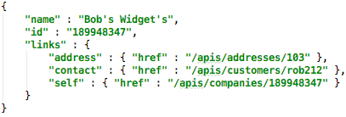
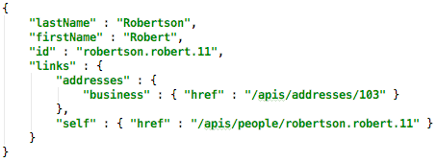
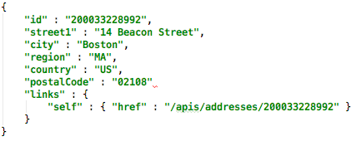
CreateCustomer
POST HTTPS://contoso.com/apis/companies
{ "name" : "Bob's Widgets", "dunsNo" : "189948347", "address" : { "street1" : "1234 Soth Street", "city" : "Boston", "region" : "MA", "country" : "US", "postalCode" : "12345" }, "contact" : { "lastName" : "Robertson", "firstName" : "Robert", "title" : "VP, Purchasing" } }

Slide 25
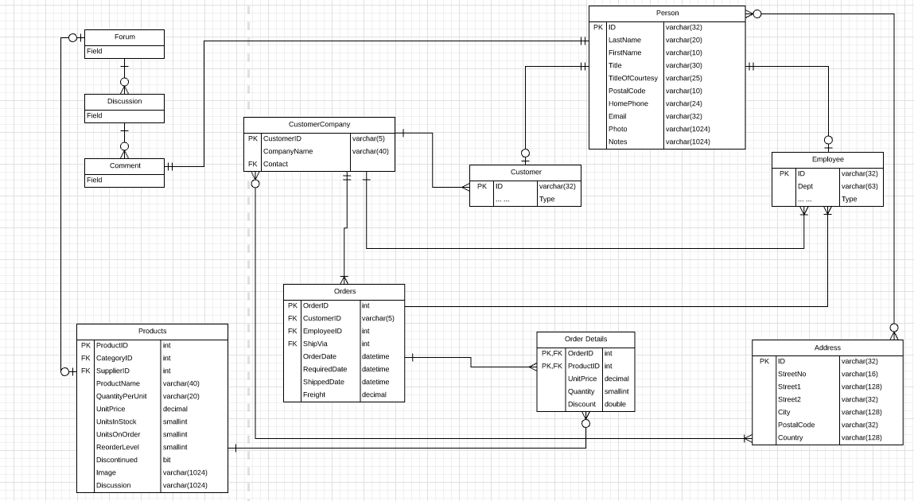
Our Modified Data Model

Slide 26
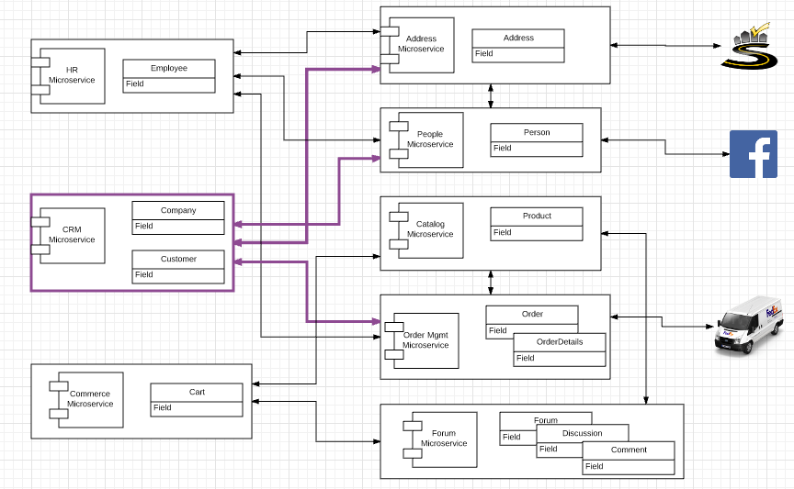
Orchestration

Slide 27
Comments
The datamodel is contrived and “over normalized.”
Each data element occurs in EXACTLY one table/microservice.
Normally, a data element has instances/copies in several locations.
We are currently focusing on core concepts.
Will handle data integration/synchronization in later lectures.
Notice that in this pattern, POST creates the URL of the form xxx/id. This example shows 3 patterns
Use an intrinsic property of the data, e.g. SSNO, DUNS No.
Generate, e.g. UUID, Auto-Increment.
Simple algorithm applied to the non-unique data to make something unique.
Your UNIs are an example.
Users are
Capable of entering data in the “Please enter your UNI” box, but
Would be unhappy if every application asked for some complex, random UUID.

Slide 28
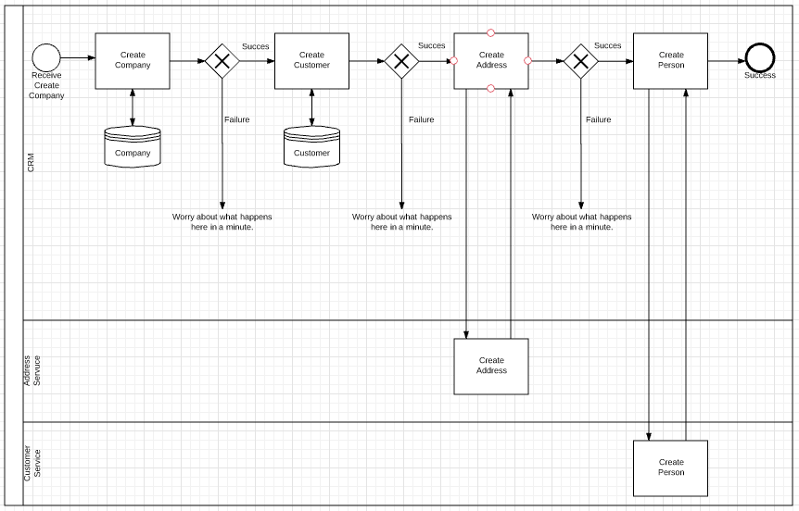
Orchestration (BPMN Diagram)

Slide 29
(Some) BPMN Symbols/Notation

Slide 30
(Some) BPMN Symbols

Slide 31
Some BPMN Symbols

Slide 32
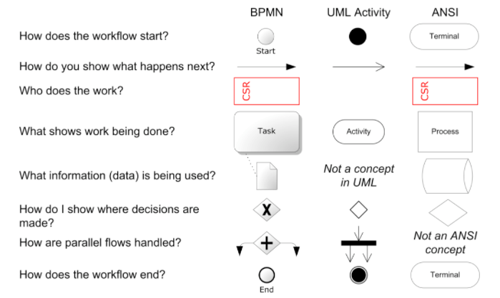
There are Many Notations

Slide 33
Flow Diagrams: 3 Perspectives
1. Use like PPT to explain/document how an application/environment functions.
2. Use like PPT to design/explain some complex code I am going to develop.
3. Emit an executable representation of the flow.

Slide 34
Flow Diagrams: 3 Perspectives
1. Use like PPT to explain/document how an application/environment functions.
(1) and (2) are probably familiar to you.
(3) is probably an unfamiliar concept. So, let’s take a quick look.
2. Use like PPT to design/explain some complex code I am going to develop.
3. Emit an executable representation of the flow.

Slide 35
Example: Alfresco Activiti BPM Suite

Slide 36
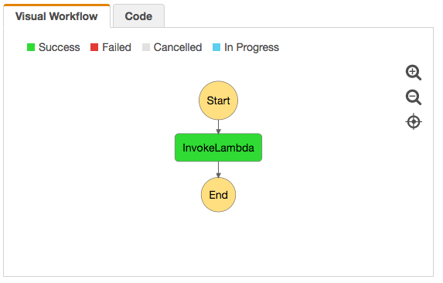
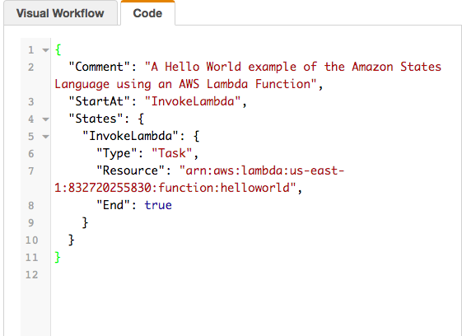
AWS Step Functions and Workflow

Slide 37
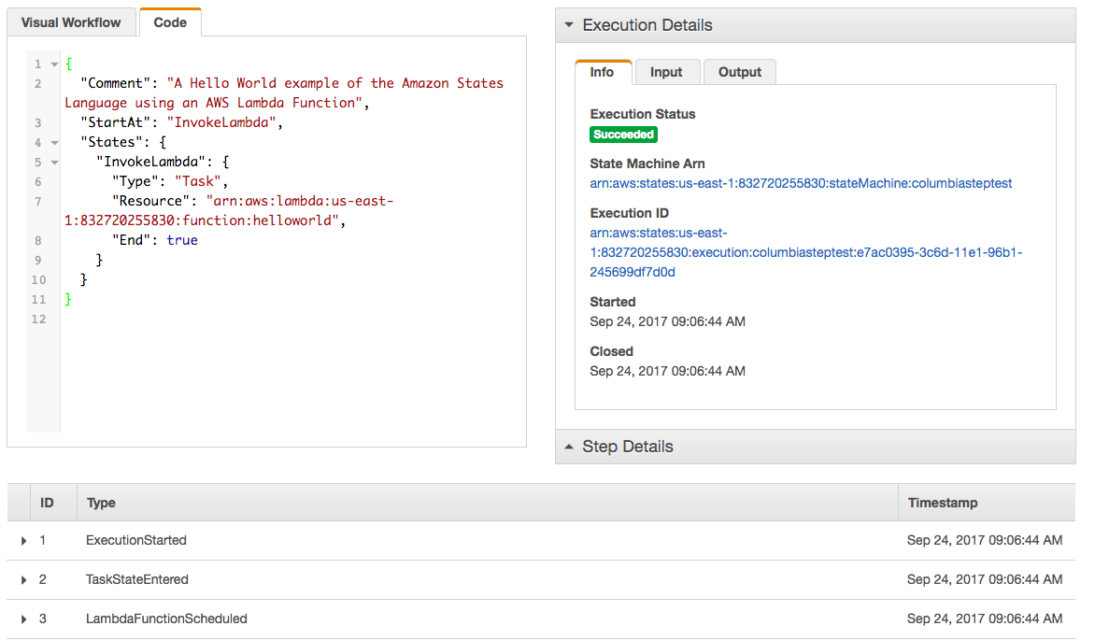
AWS Step Functions and Workflow

Slide 38
Implement with Code (Will come back to Engines)

Slide 39
Design and Implement with Code

Slide 40
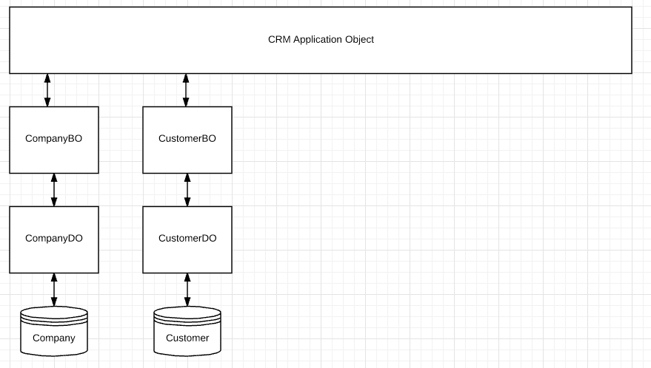
Implementation Pattern – Part I
<XXX>DO
Manages DB connections.
Maps CRUD operations to DB operations, e.g.
SELECT for RDB
GetItem for DynamoDB
Maps between DB types and <XXX>BO types, e.g. Rowset and JSON.
<XXX>BO: Implements application logic associated with an entity, e.g.
DeliveryDate is after OrderDate.
Updated addressURL resolves to valid address
<XXX>ApplicationObject implements multi-step interactions (orchestrations in code) that involve
Local <XXX>BOs
Proxies to remote <XXX>BOs.

Slide 41
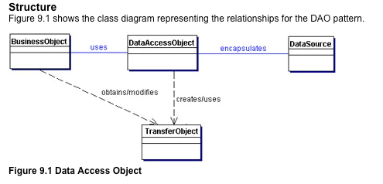
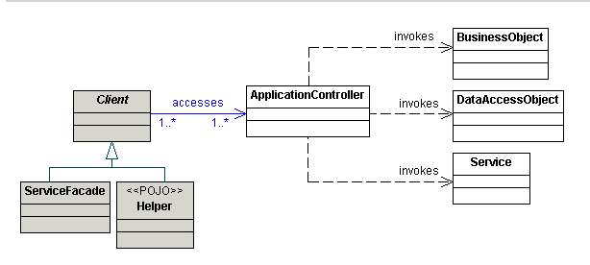
Implementation Pattern – Part I
Application (Service) Object
http://www.oracle.com/technetwork/java/dataaccessobject-138824.html
http://www.corej2eepatterns.com/ApplicationService.htm
Despite the adoption of new technology and models, e.g.
XaaS, Cloud
Microservices
The same basic application design best practices apply.
This is one pattern. Do not get hung up on which patterns among many choices, but make sure that you leverage the vast experience codified in patterns.

Slide 42
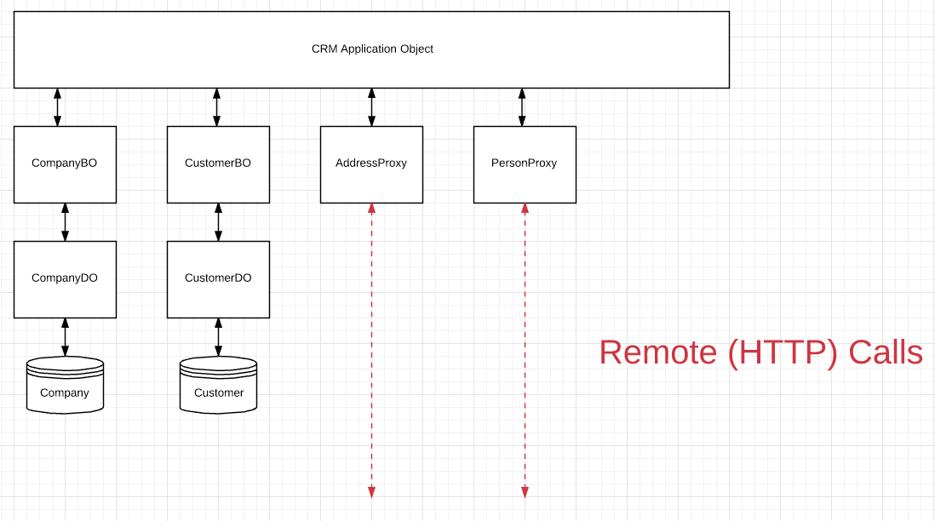
Implementation Pattern – Part II
Same interface as the <XXX>BO
Calls the actual implementation.

Slide 43
Proxy Pattern (Example Reference)
https://dzone.com/articles/design-patterns-proxy

Slide 44
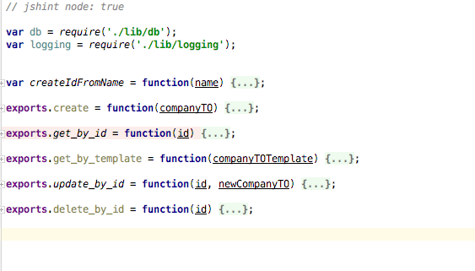
Company Data Object

Slide 45
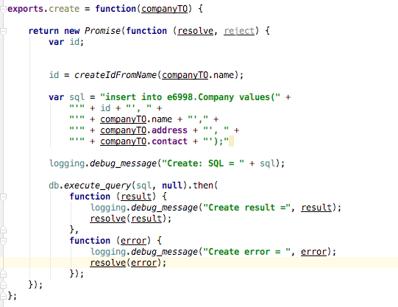
Company Data Object
Not great code, but you get the idea. The SQL-ness of it is not visible to caller.

Slide 46
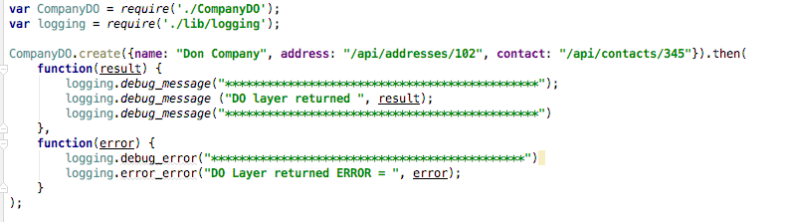
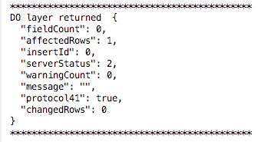
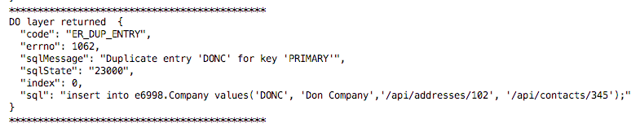
Test CompanyDO Twice
1st Time
2nd Time

Slide 47
Test CompanyDO Twice
The SQL-ness shows through.
There should be a standard architecture for DO-layer
Return codes and messages.
Data formats
Regardless of the specific DB engine.
1st Time
2nd Time

Slide 48
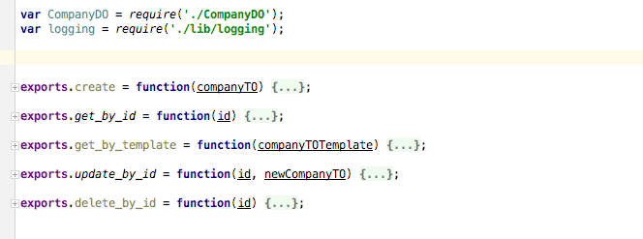
CompanyBO

Slide 49
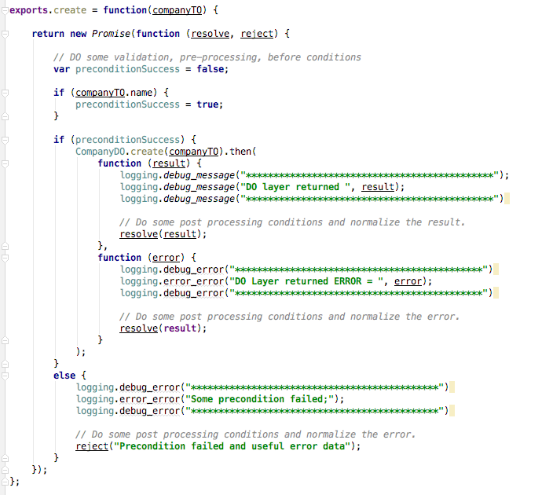
CompanyBO
Pretty straightforward
A real application would have more complicated code
Precondition validation
Post-condition
Validation
Side effects
Error recovery/retry.
Pattern is very similar for
All methods on a BO
All BOs.

Slide 50
Orchestration (BPMN Diagram)
We have seen how to build the steps.
How about the sequence?

Slide 51
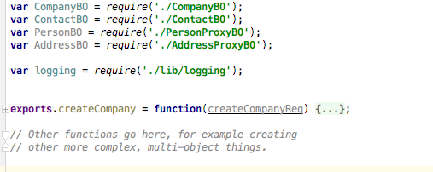
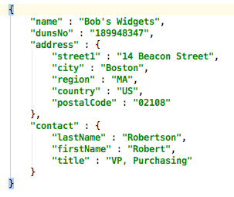
CRMService
Would prefer not to have to hardcode knowledge of using BO or Proxy.
There is a Service Locator pattern for this situation.
The code would
Require the Service Locator
Which would know whether to call was local or remote.
Wait!
I need the
Address and the Contact URLs before I can create the Company.
And the Person before I can create the Contact

Slide 52
Epic Fail!

Slide 53
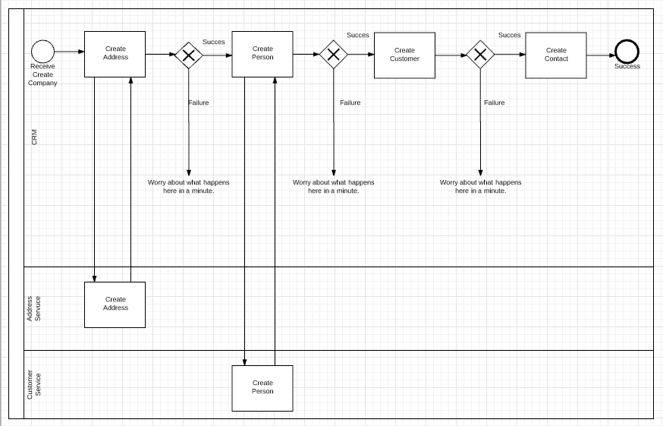
Maybe this is Better?

Slide 54
Maybe this is Better?
But you said something about this being a task?
What is the difference between a task and function call?

Slide 55
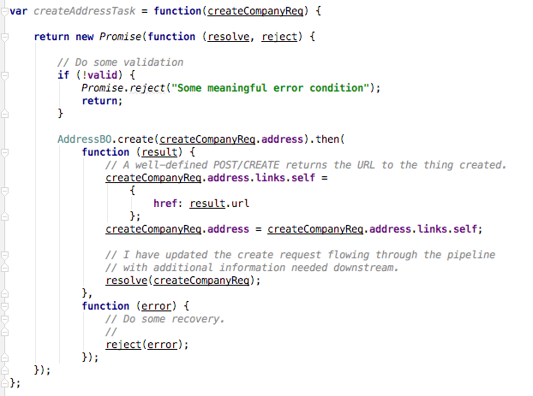
Task Versus Function Call
The task
Validates that the task input is correct.
Extracts the data needed for the function call.
Calls the function.
Validates the result.
Adds the new/updated data into the overall request.

Slide 56
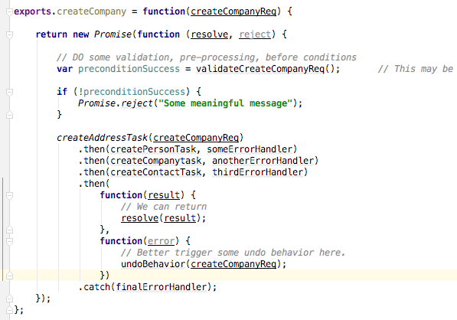
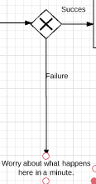
CRM Service createCompany Psuedocode

Slide 57
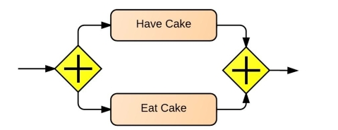
Task (Promise) Composition Patterns
Chain
Run one at a time until end or failure
A.then(b).then(c).then(d).then(e).then()
Different libraries have slightly formats for then(), catch(), finally(), etc.
You can build the chain
Explcitly concatenating in code or
By building an array.
Parallel
Promise.all().then(f1, f2)
f1 receives an array of the promise resolution on success.
f2 called when the first promise fails.
Race/Any
etc.
The actual process/service is combinations of combinations.

Slide 58
Beyond Simple Promises (http://bluebirdjs.com/docs/api-reference.html)

Slide 59
Lambda Functions

Slide 60
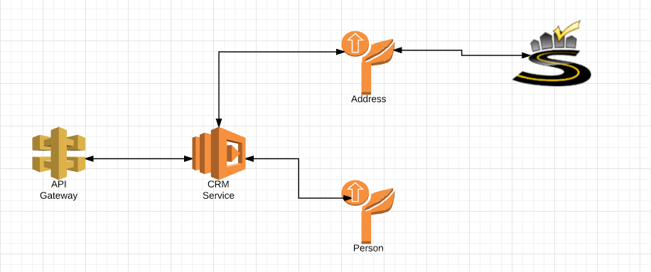
Next Project
Build on 1st to microservices
Implement the CRM Service (and HR Service) using Lambda functions.
Integrate with SmartyStreets
Deliver web content via CloudFront and S3.

Slide 61
There are 5 principles of serverless architecture that describe how an ideal serverless system
should be built. Use these principles to help guide your decisions when you create serverless
architecture.
1. Use a compute service to execute code on demand (no servers)
2. Write single-purpose stateless functions
3. Design push-based, event-driven pipelines
4. Create thicker, more powerful front ends
5. Embrace third-party services
Some observations on serverless
There is running code → “some server somewhere.”
In IaaS,
You get the virtual sever from the cloud.
But know it is there, and manage and config it.
In PaaS/microservices
You are aware of/build the “application sever.”
And supporting frameworks.
And bundle/tarball it all together.
In serverless,
You write a function based on a template.
Upload to an internet “event” endpoint.
Anything you call is a “cloud service.”

Slide 62
Let’s build a Lambda function.
Let’s publish through the API Gateway

Slide 63
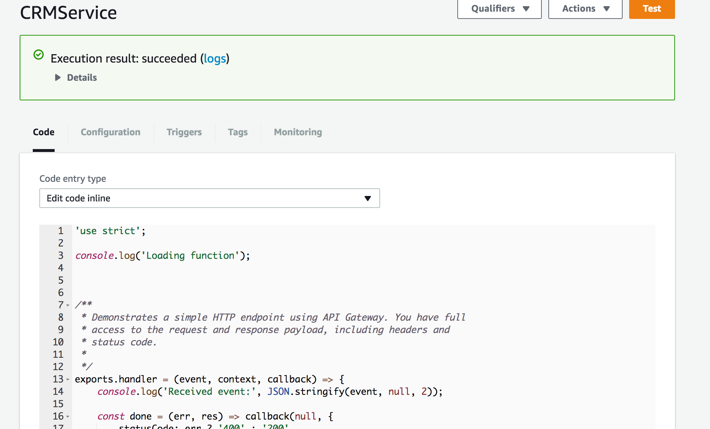
Lambda Function

Slide 64
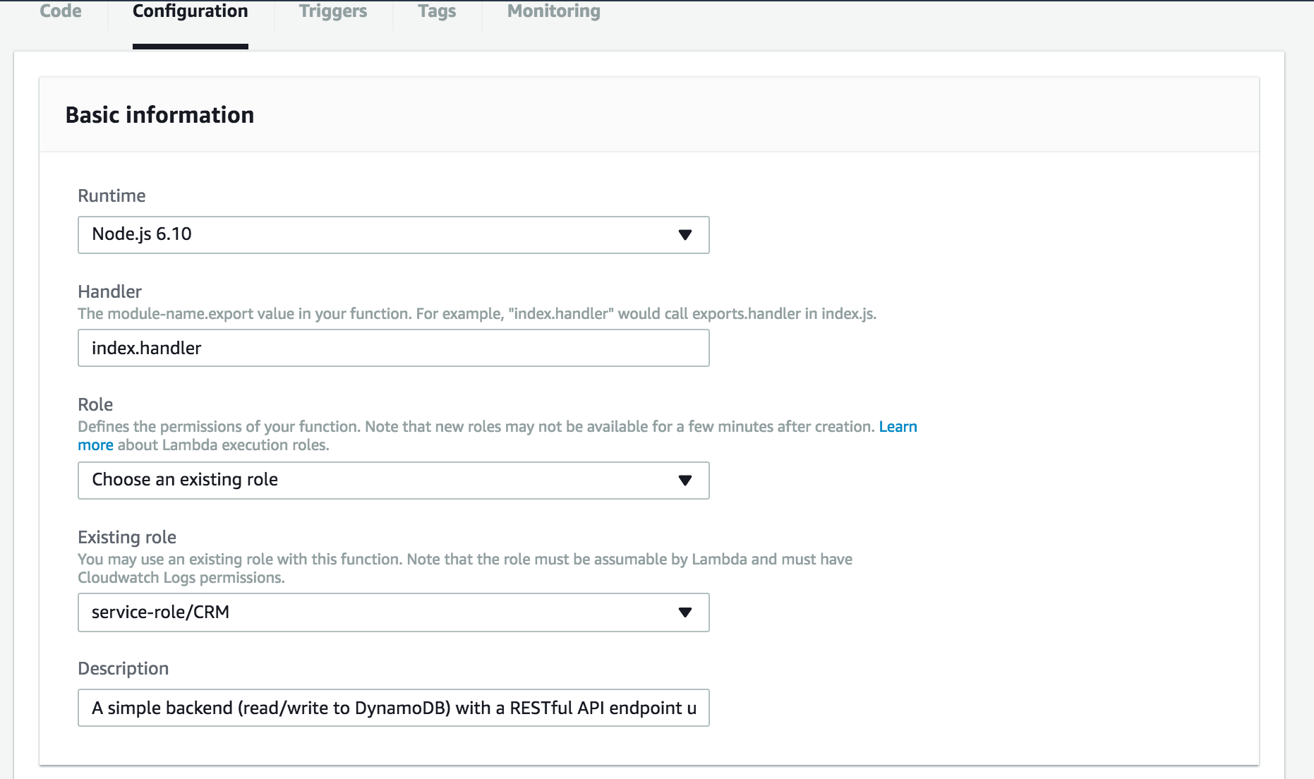
Lambda Function

Slide 65
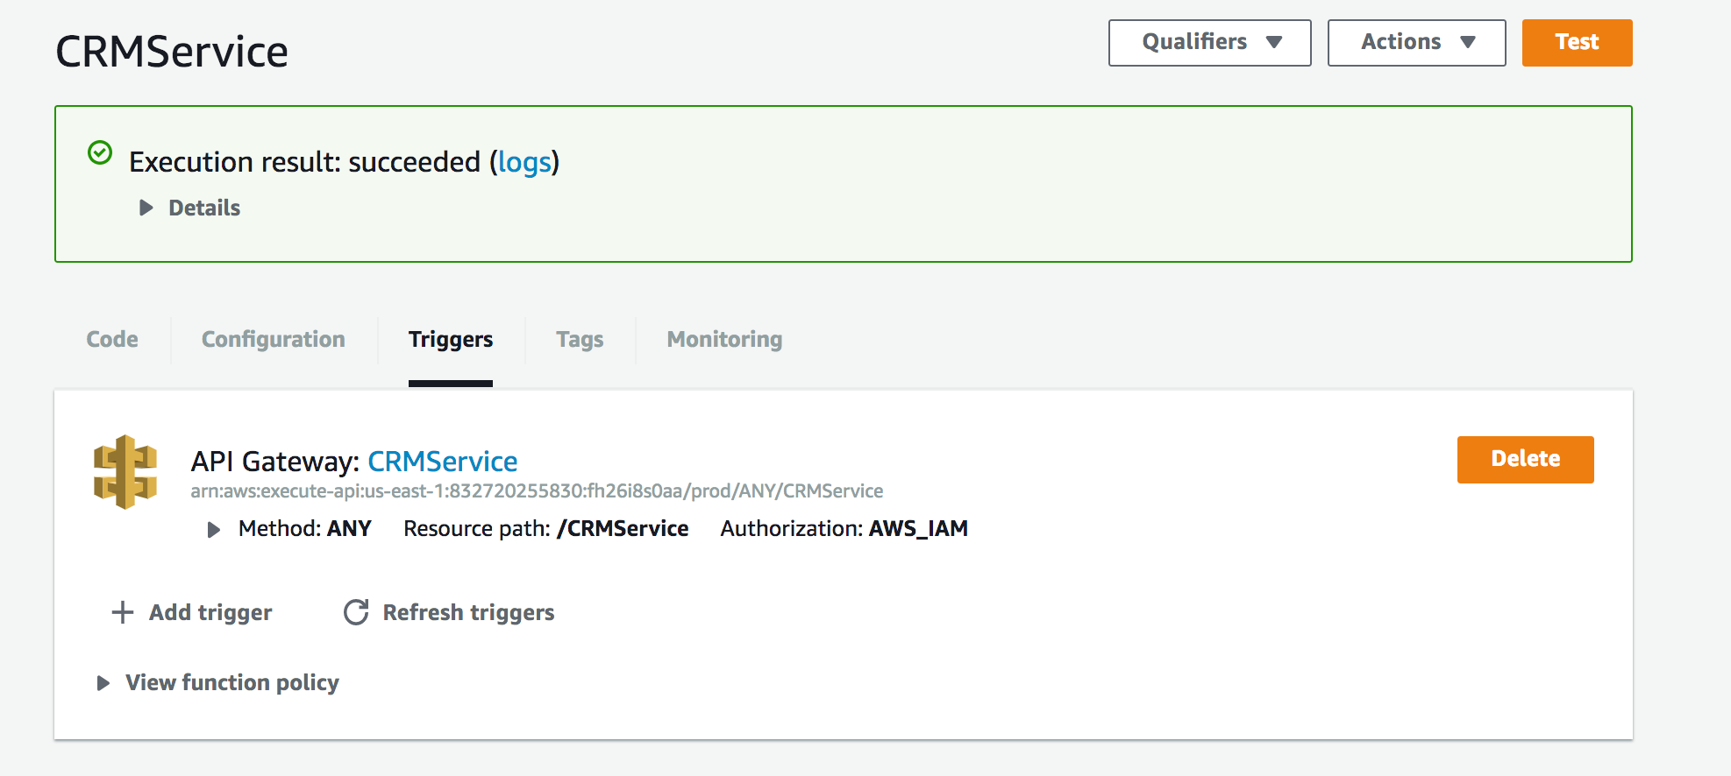
Lambda Function

Slide 66
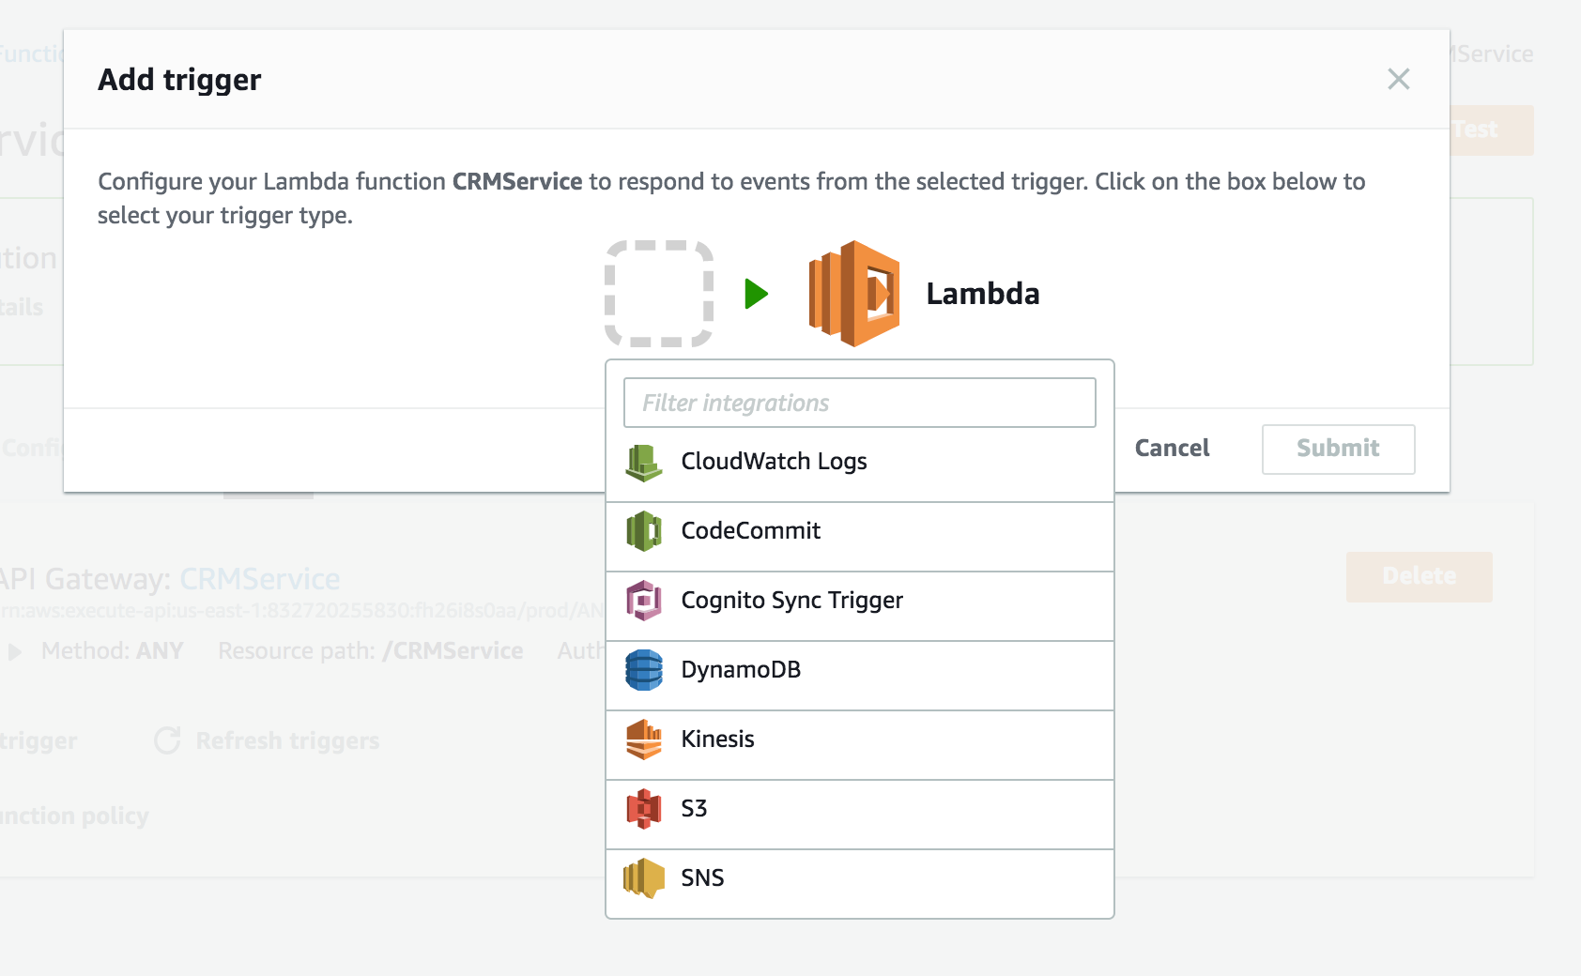
Lambda Function

Slide 67
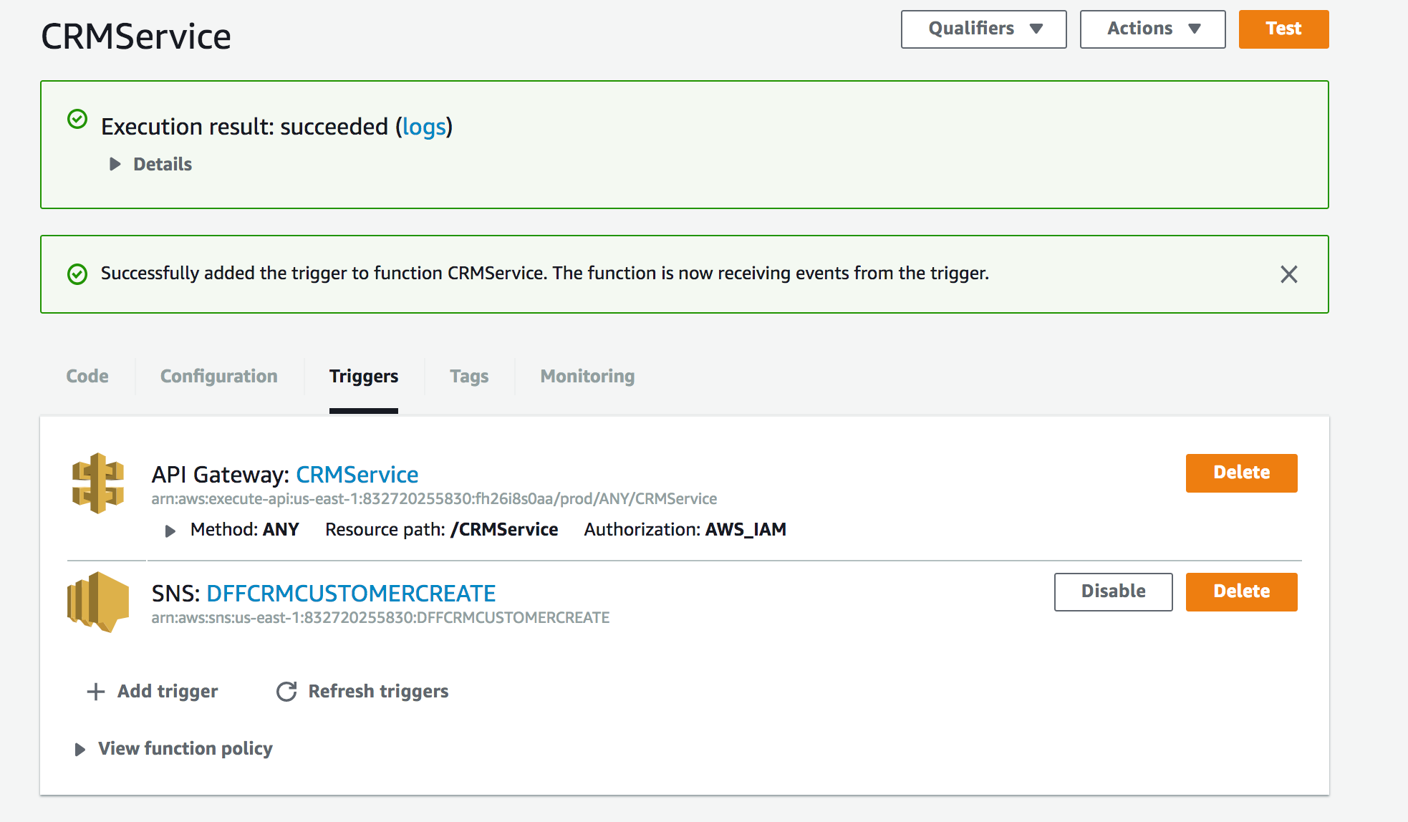
Lambda Function

Slide 68
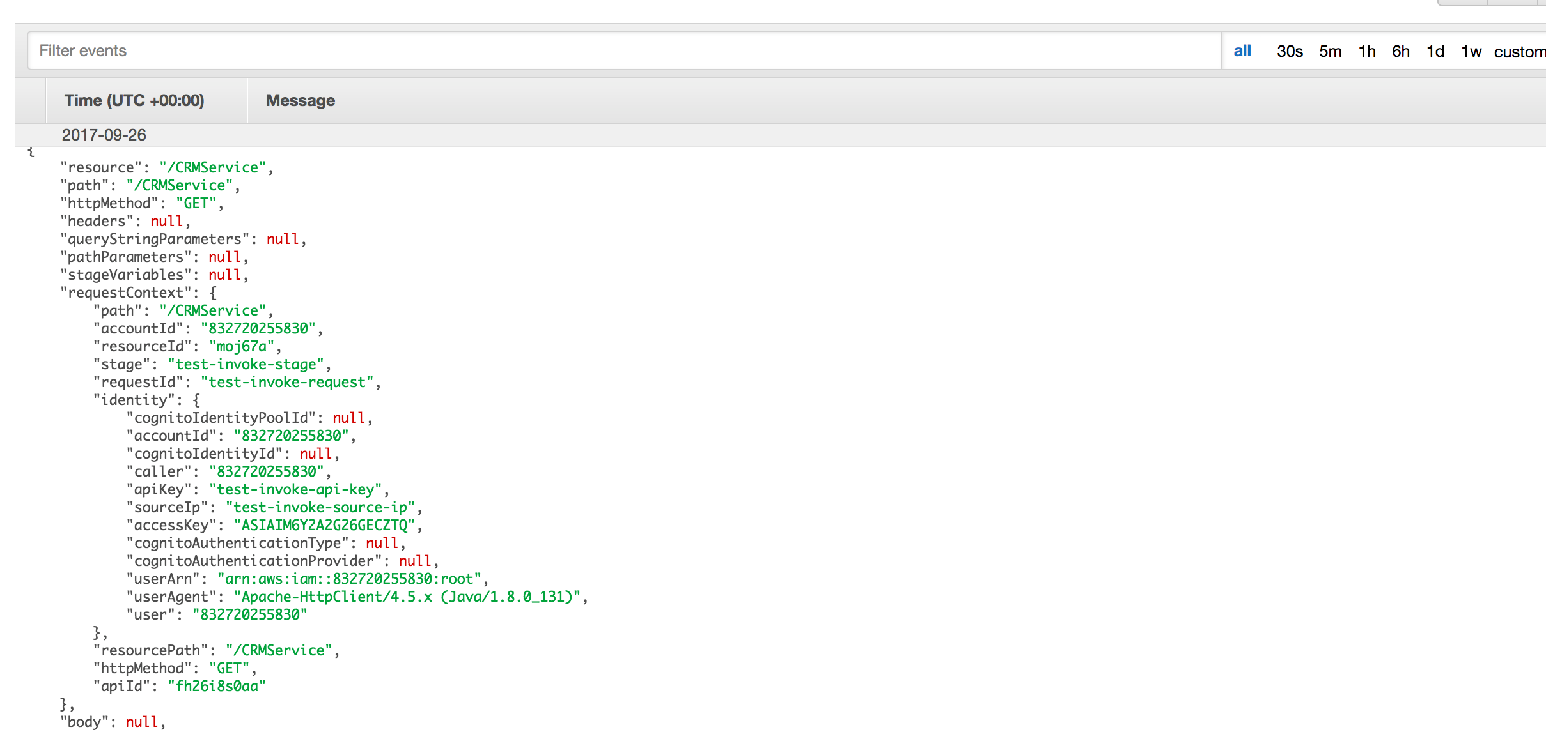
Execution

Slide 69
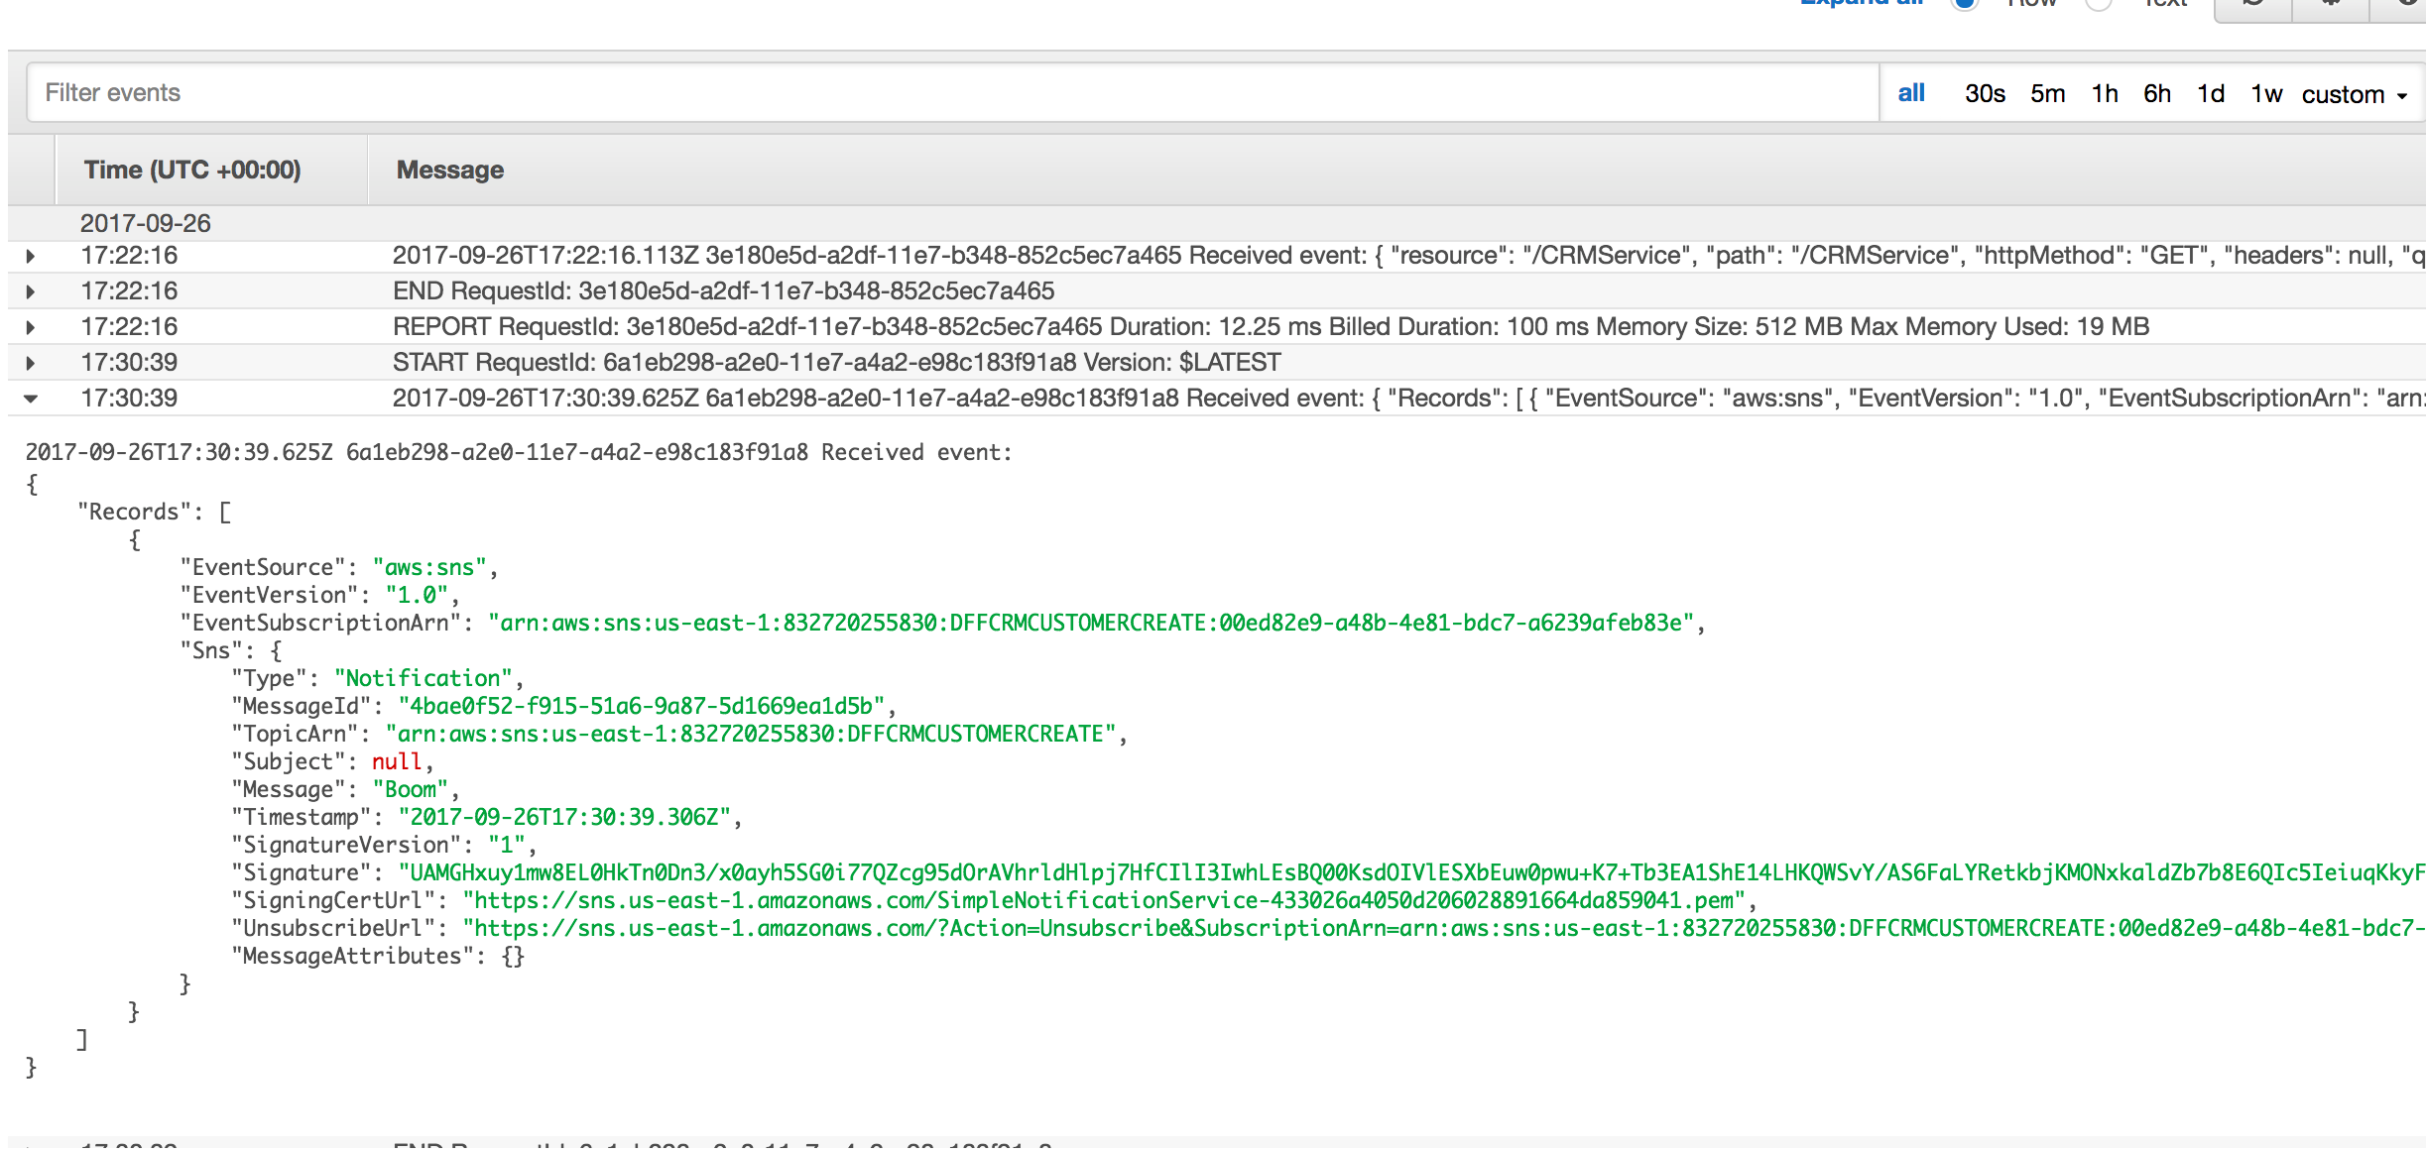
Execution

Slide 70
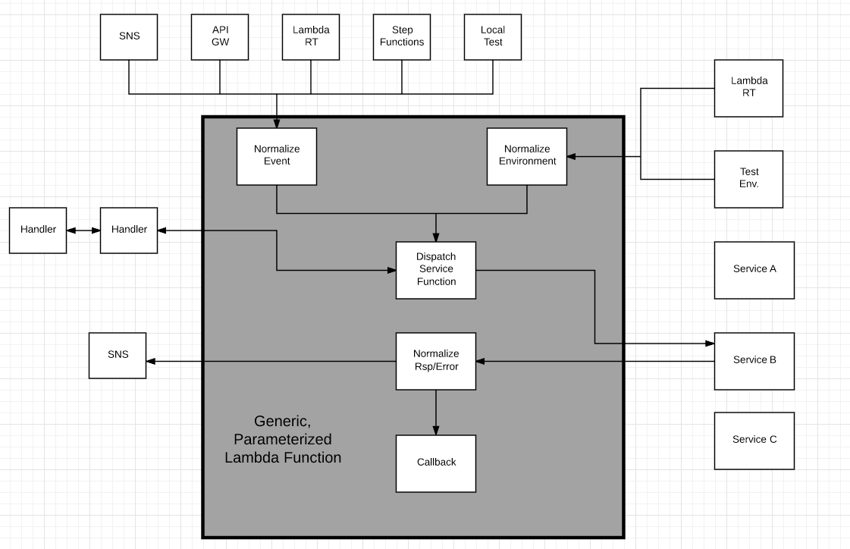
Design Pattern – Generic Lambda Function
Options
In zip file
Separate Lambda
Config info
Added to Lambda
Env Variable
From S3

Slide 71
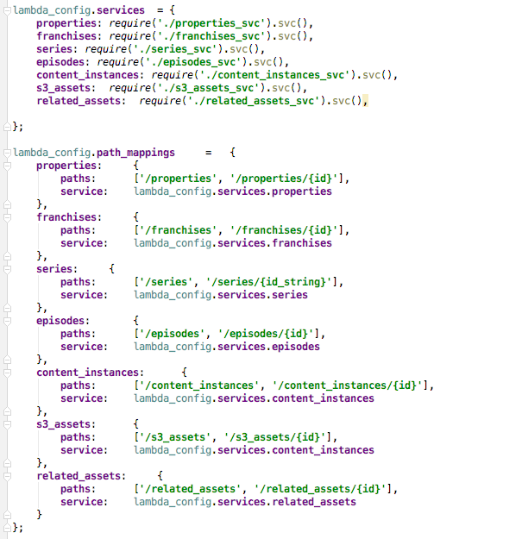
Generic Lambda Function
Multiple paths may map to the same Lambda function (or microservice), which dispatched onto sub modules.
Load submodules from zip/deploy bundle. These may be
The actual implementation code.
A proxy that invokes the code deployed in a separate Lambda function.
A proxy that invokes the code via HTTP.
etc.
Relies on
The module all having the same basic “shape.”
Being binding (HTTP, local call, Lambda) independent.

Slide 72

Generic Lambda
Echo
Test connectivity.
Heartbeat for monitoring
Pass not “REST” verbs directly to service.

Slide 73

Configured Service
In an extreme case, a specific service can just delegate onto a generic service and pass configuration information.

Slide 74

Configured Service
Automatically set generated values, e.g.
Created, Modified
UUID
Validate body
All required fields.
No extra fields.
Apply constraint functions.
Process data returned from DB layer.
Return on fields that match definition.
Convert foreign keys into links.
… …

